Slide 1


R Markdown
Lewis Mews

Slide 2
__ideas__
- what is R markdown? Go over the basics
- why would you use it?
- Go over a few examples of how you would present findings without RMD: build an r script, run it,write it up in word/powerpoint. Issue is you need to change it every time you run a new model.
- With RMD you can easily set up a base script and have it update every time you run a new model.
- Explain how we use it to generate monthly reports.
- Go over a basic demo of how it looks, some simple plots, some typical errors.
- Go over how a more complex RMD file may look.
- Wrap up with some Pros and Cons.

Slide 3
All the material with scripts/examples can be downloaded from my gogs directory

Slide 4
What is R markdown
Use cases
Go through a script
Pros and Cons
Summary

Slide 5
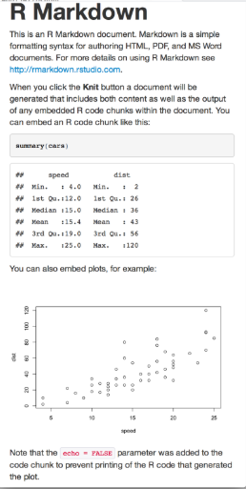
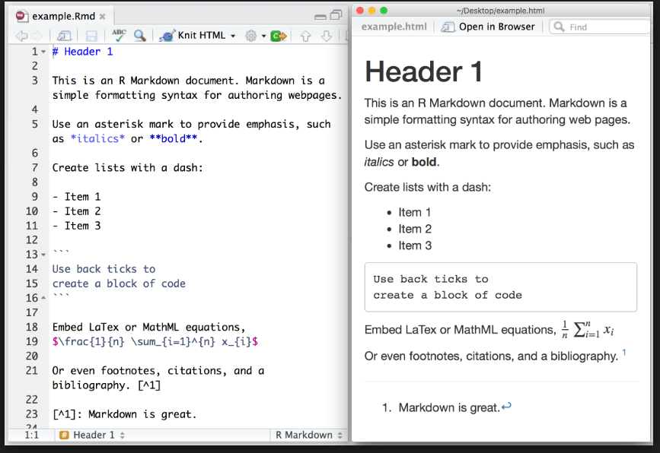



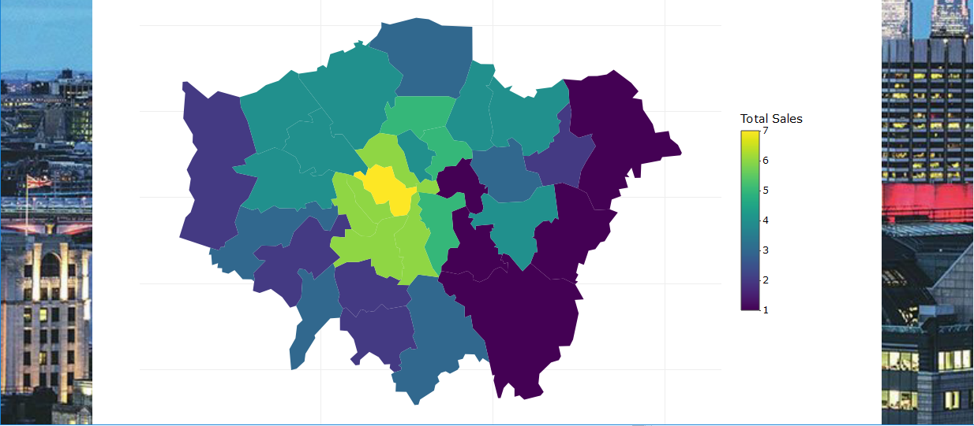
What is R Markdown?
Markdown: Lightweight ‘markup’ language written in plain text. Whole point was to have something easy to read which can be converted into HTML.
Text-to-html conversion tool, using pandoc
Used to generate HTML in an easy to read format
R Markdown combines the core syntax of markdown with embedded R chunks to create dynamic documents. – allows the combination of R code,plots and text to create reports/presentations
- Word/pdf
ReadME

Slide 6
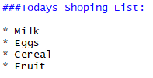
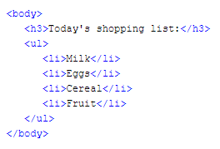
HTML Vs RMD

Slide 7
YAML header
Structure of your file.
Title
Auther
Date
Type of output
css
Notes:
Yet Another Markup Language now stands for YAML Ain't Markup Language

Slide 8
Headers – 6 layers
__X__/**X** - bold
_X_/*X* - italics
*/-/+ - bullet points
1) – numbers
[Link Name] (link URL) – hyperlink
![alt text](path/image) – image
Double space, ---,

Slide 9
Code chunk has 3 parts
‘’’
{} – echo/results/fig.height
Code
Need to install – rmarkdown/knitr
- something to read pdf = miktex

Slide 10
What its used for
Presents your code alongside its output in an easy to read format.
Good for paper/assignment. Upload code to github.
Automation of reports
Notes:
<center> <h1>heading 1</h1> </center> indents the title

Slide 11
What is it
First pick your r markdown default type/ can also put auther and title
Yaml header – put all the top line stuff like title/auther/type/date/font/page margins
Main bit of r code – set global options and load packages
All other text/R code

Slide 12
What is it
Open test
Explain what it all is
Delete it all and start one from scratch, loading library(datasets) and using one from there.
Put in some headings. Then Have pre done text to copy in and explain what different things do
Go through settings. Can change default picture sizes. They get put in the top. Fig.cap also has the caption. Also each plot has a settings.

Slide 13
Why
Super easy to use
Combines r models/plots with plain text
- reports
- explain models

Slide 14
What formats are supported
Slidy
Ioslides
Html
Notebook
Pdf
rtf
Word
Latex
Dashboard
Tufte handout
Shiny
Beamer

Slide 15
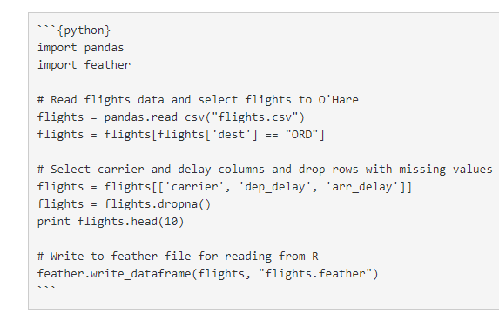
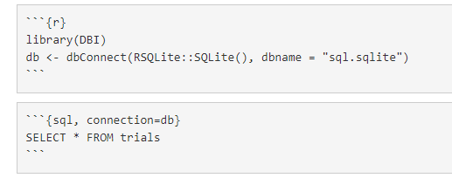
What languages are supported
Scala
Rcpp
C
R
Ruby
SQL
Python
Bash

Slide 16
Useful Links

